Slide 1
Autonomous Assistive Robot with dynamic navigation and person tracking
Team D05:
Rangala Kartikeya
Tanguturi Vinay Krishna Chetty
Sai Kartikeya Vasireddi
Sai Akhilesh Y
CB.SC.U4AIE23333
CB.SC.U4AIE23341
CB.SC.U4AIE23345
CB.SC.U4AIE23348

Slide 2
Problem Statement and objective:
Assistive robots play a crucial role in helping individuals with navigation and tracking.
Current systems often lack adaptability, face challenges in real-time person tracking, or are ineffective in complex indoor spaces.
An efficient assistive robot should accurately detect its environment, monitor individuals seamlessly, and ensure safe navigation.

Slide 3
So, we are trying to:
Develop an autonomous assistive robot that can:
Navigate dynamically in real-world indoor environments.
Track and follow individuals while avoiding obstacles.
Process sensor data for intelligent decision-making.
Web application for Human-Robot Interaction, communication and reminders.
Speech to text conversion.

Slide 4
Literature Review:
Paper | Authors | Date | Summary
Autonomous Person-Specific Following Robot | Abdullah Mujahid; Akhtar Kalam; Seyed Morteza Alizadeh; Yuanyuan Fan | 15 October 2020 | This paper presents a robust person-tracking system for assistive robots. It integrates RGB-D and LiDAR sensors to follow a specific individual, even in dynamic environments with occlusions and varying lighting conditions. It introduces the Sequential Nearest Neighbour with Thresholding Selection (SNNTS) algorithm for accurate real-time tracking.
Autonomous Robot Navigation in Dynamic Environments Using Deep Reinforcement Learning | Paloma de la Puente, Markus Vincze, Diego Guffanti, Daniel Galan | 3 March 2021 | This study applies Deep Reinforcement Learning (DRL) to enable robots to autonomously navigate complex indoor spaces with moving obstacles. The approach removes the need for pre-mapped environments, allowing real-time adaptation to surroundings.
Human Following Robot | Ester Martinez-Martin; Angelo Costa | 20 July 2022 | Explores human-following behavior in assistive robotics, discussing machine learning-based person tracking, obstacle avoidance, and movement prediction. It compares multiple tracking approaches, emphasizing sensor fusion for accurate user detection.

Slide 5
Research Gap:
Existing research lacks real-time adaptive navigation for unpredictable environments.
Current assistive robots do not offer personalized human-robot interaction.
Most studies rely on limited sensor types, missing robust multi-sensor fusion.
Integration with hospital and home-care systems remains a major challenge.
Our project addresses these gaps using real-time AI, sensor fusion

Slide 6
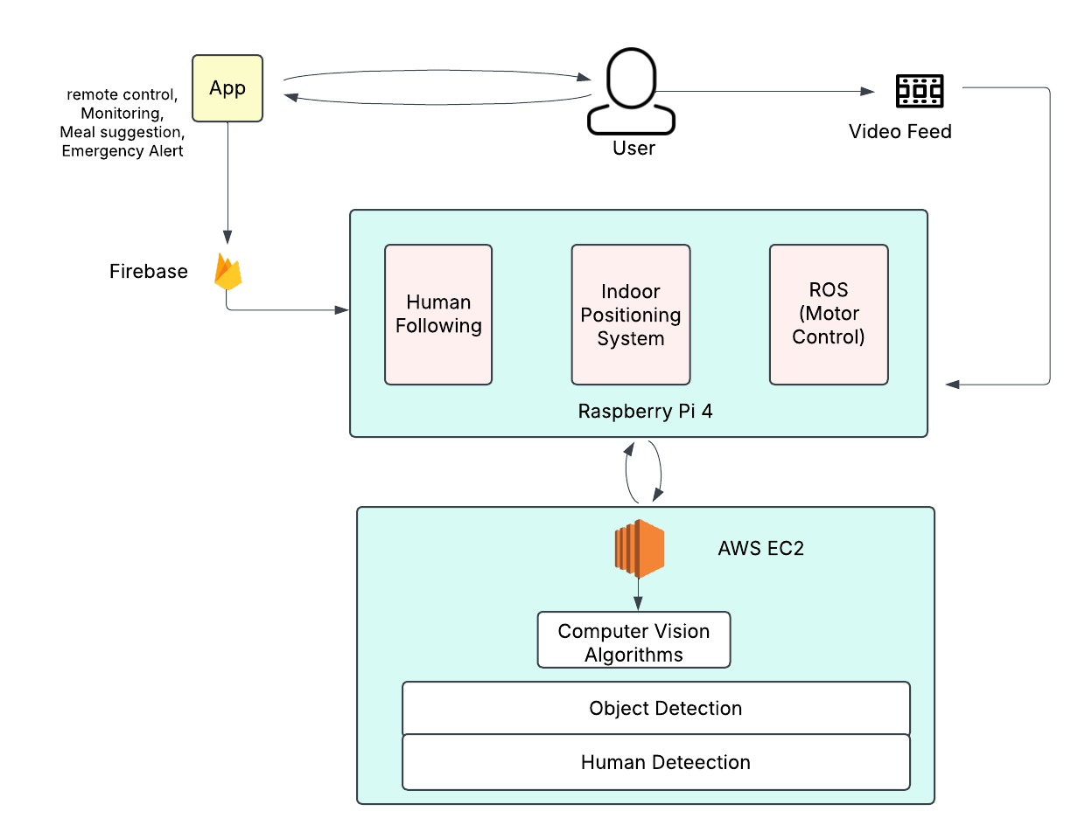
Proposed method:

Slide 7
Implementation of our project:
Software Implementation:
Live Feed
Remote Movement in the Application
Hardware Implementation:
Autonomous Tracking a person through complex indoor systems
Speech to text

Slide 8
Implementation we have completed:
Software Implementation:
We have Successfully implemented a sign up page to sign up and create an account in the Web application
We have created a database connection to the web page to save login info to sign in again.
We have created a web page UI to have two types of tracking
One is with Remote control from the Web application
One provide the person tracking Live feed (To be Done).
Created a connection between the Raspberry pi and database and the information is being passed through.

Slide 9
Implementation to be done:
Hardware Implementation:
We need to implement the Person tracking for the robot.
Provide live video feed in the web application and get as less latency and much frames as possible.
Develop a web-based interface to send movement commands to the robot.
Ensure seamless navigation through manual or automated controls.

Slide 10


Quantum Face Encoding & Recognition (Quantum Embeddings Representation)
The system converts a face into a quantum state representation using Quantum Convolutional Neural Networks (QCNNs).
Feature Extraction using Quantum Circuits
A quantum state is prepared using parameterized quantum gates:
Where:
U(θ) is a unitary transformation applied to qubits.
The rotation parameters θ encode facial features.
Non-Linearity with Quantum Entanglement
Quantum circuits introduce non-linearity using entanglement:

Slide 11

Face Matching Using Quantum Fidelity
The system compares faces using Quantum Fidelity instead of Euclidean Distance:
Where ρ1, ρ2​ are quantum density matrices representing face embeddings.

Slide 12
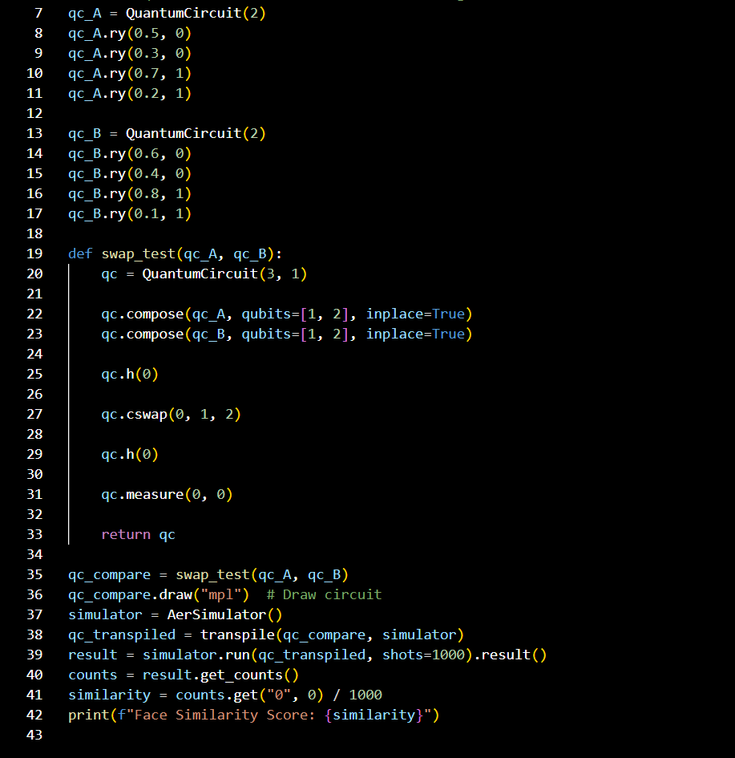

Slide 13
Person Detection Using MobileNet SSD
1. Object Detection Process
The MobileNet SSD model detects a person in the frame.
It outputs:
Bounding Box: (x, y, w, h)
Confidence Score: S∈[0,1]
2. Bounding Box Representation
A detected person’s location is represented as:
B=(xmin,ymin,xmax,ymax)
where:
xmin,ymin​ = top-left corner of the box
xmax,ymax​ = bottom-right corner

Slide 14


Slide 2: Person Tracking with Motion Estimation
1. Tracking Across Frames (Data Association)
For each new frame, we match detected bounding boxes using centroid tracking.
Centroid of a bounding box:
Matching Rule: Find the closest centroid in the next frame using Euclidean distance:
If d(Ci,Cj) is small, associate detections between frames.

Slide 15


Predicting Movement with Kalman Filter
The filter assumes the person moves in a straight line with some speed.
It updates the estimated position using:
When the camera sees the person again, it compares the predicted
position with the actual detected position.
The error (difference) is used to refine the estimate using:
Where:
Zk = New measurement (detected position).
H = Measurement matrix (maps the state to observations).
K = Kalman Gain (decides how much to trust the new data).
Xk​ = Predicted state (x,y,vx,vy)(
A = State transition matrix (describes movement).
U = External control input (if the robot actively moves).
W = Small random error (to account for uncertainty).

Slide 16
Different Phases of the Project:
Week 1: Planning and Component Collection
Week 2: Environment Setup
Week 3: Web Application Development - Frontend
Week 4: Web Application Development - Backend
Week 5: Person Tracking and Object Detection
Week 6: System Integration and Testing
Week 7: User Feedback and Iteration
Week 8: Finalization and Deployment

